Slide 1

Cybersecurity club

Slide 2

AGENDA
Cybersecurity News
Importance of Cryptography
Plaintext to Ciphertext
Historical Ciphers
Types of Encryption
The Math
Social Media
Questions

Slide 3

Cyber News
Iran-linked hackers claim responsibility for attack on US medical device maker Stryker
Used wiper malware to erase 200,000 Stryker devices and extract 50TB of data
Shut down operations for the US medical device giant across 79 countries
The cyber-attack as direct retaliation for a recent military strike on a girls' school
Did not involve a ransom demand
Manipulated the company's remote device management tools to execute the attack
150 million patients rely on Stryker

Slide 4

Importance of Cryptography
Cryptography’s ultimate purpose is to ensure secure communication in the presence of opposition
Cryptography is the science of securing information by converting it into unreadable code (ciphertext) to ensure only authorized parties can read it
It is used everywhere in the world like Credit Cards, Medical Data, Passwords, and a lot more things

Slide 5
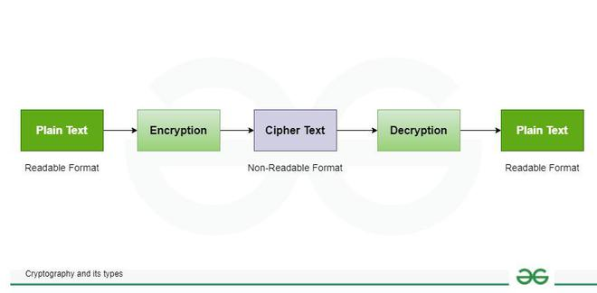
Plaintext to Ciphertext
Plaintext is the original, readable message or data before it’s encrypted
Ciphertext is the scrambled, unreadable version of the message after encryption
Cipher is an algorithm or method to convert plaintext into ciphertext and back again
Key is a string of bits the cipher uses to encrypt or decrypt data
Encryption is the process of converting plaintext into ciphertext using a cipher and a key
Decryption is the reverse process of encryption, converting ciphertext back into plaintext using a cipher and a key

Slide 6

Historical Ciphers
Cryptography has been around in Egypt sense 1900 BCE
The simplest cypher is a shift cypher
Caesar Cypher
Other historical Cyphers are
Vigenère (16th century)
Enigma machine (World War II)
One-Time Pad (Cold War)
Do task 1

Slide 7
Types of Encryption
Symmetric Encryption
uses the same key to encrypt and decrypt the data
The key is called the private key
Communicating the key to the other party is kinda hard
DES (Data Encryption Standard) , 3DES (Triple DES), AES (Advanced Encryption Standard)
Asymmetric Encryption
uses a pair of keys, one to encrypt and the other to decrypt
It uses a public and private keys
Data encrypted with the public key can be decrypted with the private key
RSA, ECC (Elliptic Curve Cryptography), and Diffie-Hellman
Mathematical problems that are easy to compute in one direction but extremely difficult to reverse

Slide 8
The Math
XOR or the "exclusive OR"
In binary XOR compares two bits and returns 1 if the bits are different and 0 if they are the same
Symmetric encryption
P is the plaintext, and K is the secret key. The ciphertext is C = P ⊕ K
C ⊕ K = (P ⊕ K) ⊕ K. But we know that (P ⊕ K) ⊕ K = P ⊕ (K ⊕ K) because XOR is associative
K ⊕ K = 0; consequently, (P ⊕ K) ⊕ K = P ⊕ (K ⊕ K) = P ⊕ 0 = P
A | B | A ⊕ B
0 | 0 | 0
0 | 1 | 1
1 | 0 | 1
1 | 1 | 0

Slide 9
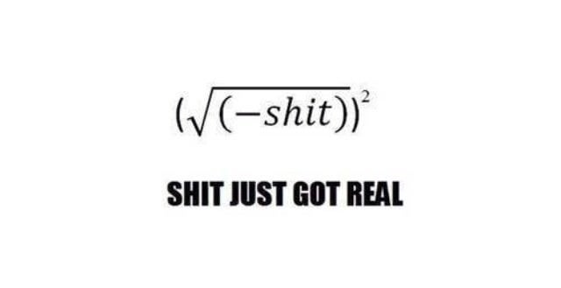
More math
Modulo Operation
commonly written as % or as mod
The modulo operator, X%Y, is the remainder when X is divided by Y
25%5 = 0 because 25 divided by 5 is 5, with a remainder of 0, i.e., 25 = 5 × 5 + 0
23%6 = 5 because 23 divided by 6 is 3, with a remainder of 5, i.e., 23 = 3 × 6 + 5
23%7 = 2 because 23 divided by 7 is 3 with a remainder of 2, i.e., 23 = 3 × 7 + 2
modulo is that it’s not reversible
Do task 2

Slide 10
RSA
RSA is based on the mathematically difficult problem of factoring a large number
Multiplying two large prime numbers is a straightforward operation
113 × 127 = 14351
two prime numbers: p = 157 and q = 199 n = p × q = 31243
ϕ(n) = n − p − q + 1 = 31243 − 157 − 199 + 1 = 30888
e = 163 such that e is relatively prime to ϕ(n); moreover, he selects d = 379, where e × d = 1 mod ϕ(n), i.e., e × d = 163 × 379 = 61777
61777 mod 30888 = 1
The public key is (n,e), i.e., (31243,163) and the private key is $(n,d), i.e., (31243,379)
The value they want to encrypt is x = 13
Calculate and send y = x^{e} mod n = 13¹⁶³ mod 31243 = 16341
decrypt the received value by calculating x = y^{d} mod n = 16341³⁷⁹ mod 31243 = 13

Slide 11



Social Media
Instagram
Discord
https://dsc.gg/bsucyber
Be Connected
(Attendance)

Slide 12

Questions

